Slide 1

ANTI COLLISION
Department of Electronics and communication
Bengal College of Engineering & Technology Durgapur, W.B.
SUBMITTED BY-
BHANU PRAKASH AGRAWAL(12500313028)
GAURAV KUMAR(12500313037)
MD. ASIF(12500313051)
AKRAMUL ALI(12500313009)
AVDHESH KUMAR(12500313026)
UNDER THE GUIDANCE OF:
DR. L K BANDYOPADHYAY ,
PROFESSOR
DEPT OF ECE)

Slide 2
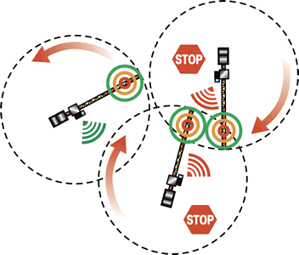
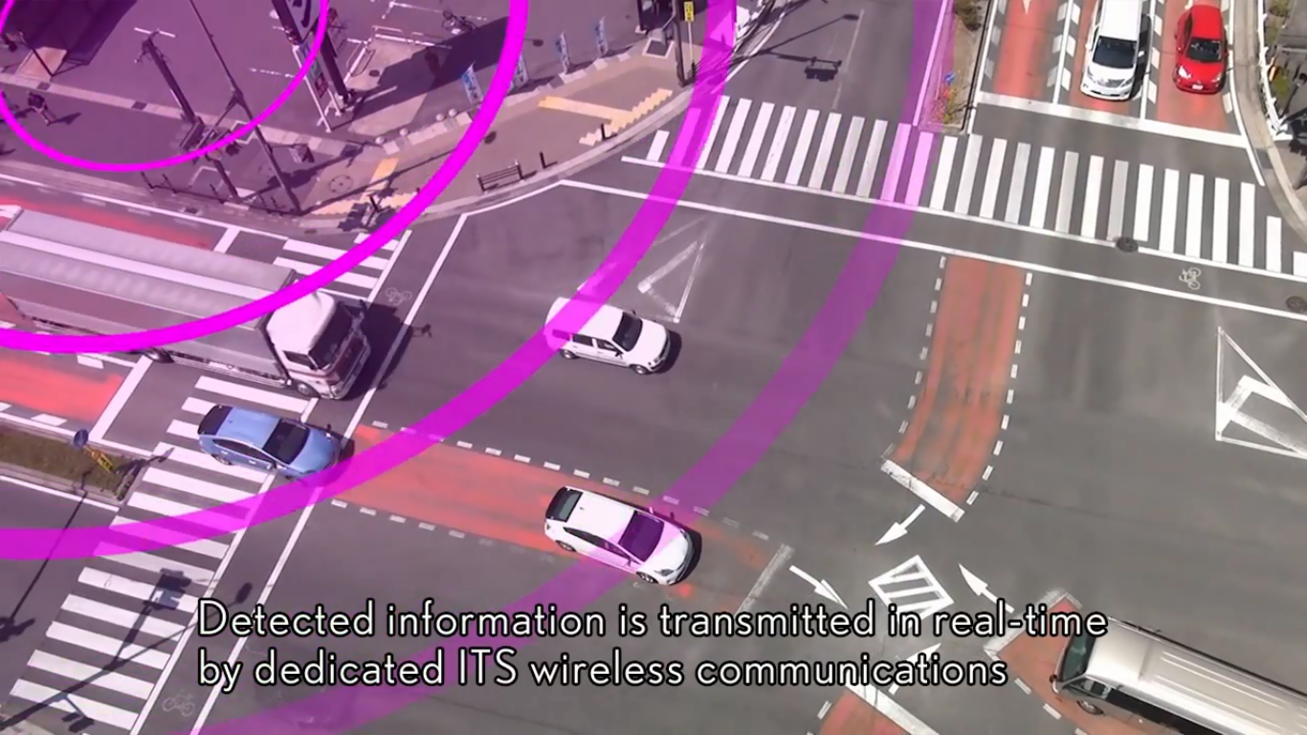
ANTI COLLISION SYSTEM

Slide 3
WHAT IS ANTI COLLISION
Anti collision is a system designed to prevent rear‐FRONT end collisions.
There are two kinds of safety systems :
Passive safety
Active safety

Slide 4
ACTIVE AND PASSIVE SAFETY
The terms "active" and "passive" are simple but important terms in the world of automotive safety.
ACTIVE DISPLAY is used to refer to technology assisting in the prevention of a crash
PASSIVE SAFETY to components of the vehicle (primarily airbags, seatbelts and the physical structure of the vehicle) that help to protect occupants during a crash

Slide 5
Outlines-
Need of ANTI COLLISION
System Configuration
Hardware description
Software description
Challenges faced
How it works
conclusion
Advantage and Disadvantage
Warning devices
methodology

Slide 6
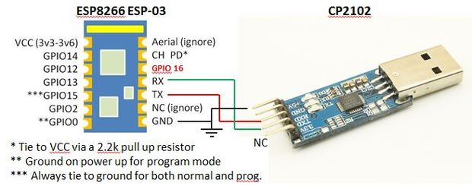
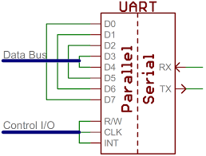
SYSTEM CONFIGURATION:-
UART Communication WITH WIFI ESP

Slide 7
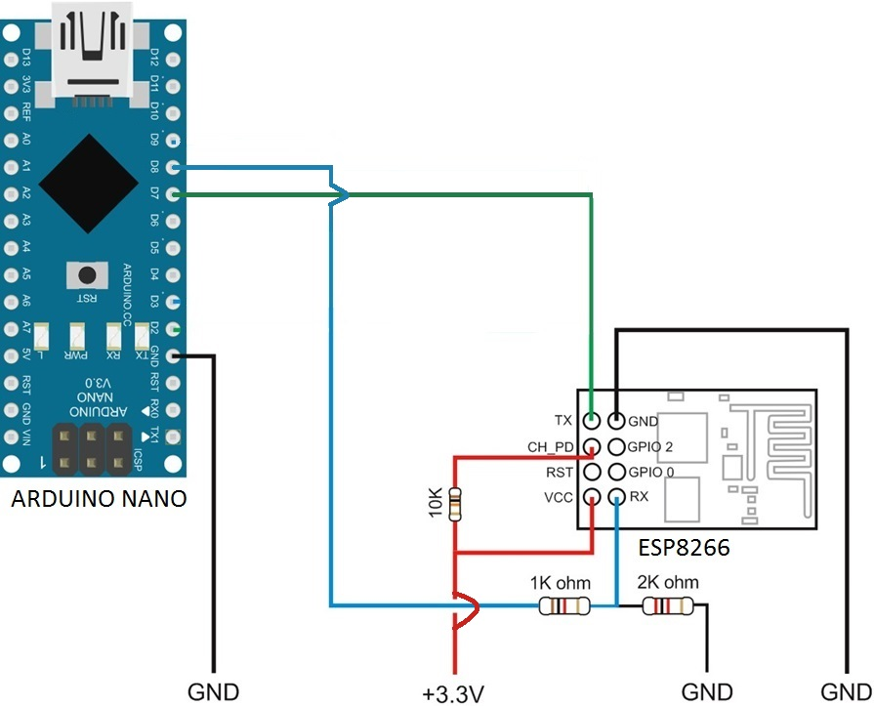
UART COOMUNICATION WITH WIFI ESP
The universal asynchronous receiver/transmitter (UART) takes bytes of data and transmits the individual bits in a sequential the destination, a second UART re-assembles the bits into complete bytes
Each UART contains a shift register which is the fundamental method of conversion between serial and parallel forms

Slide 8
WIFI AT COMMUNICATION
Wi-Fi AT command ESP8266 offers a complete and self-contained Wi-Fi networking solution, allowing it to either host the application or to offload all Wi-Fi networking functions from another application processor.
The ESP8266 is now one of the leading platforms for the Internet of Things. It’s super cheap, and super easy to work.

Slide 9
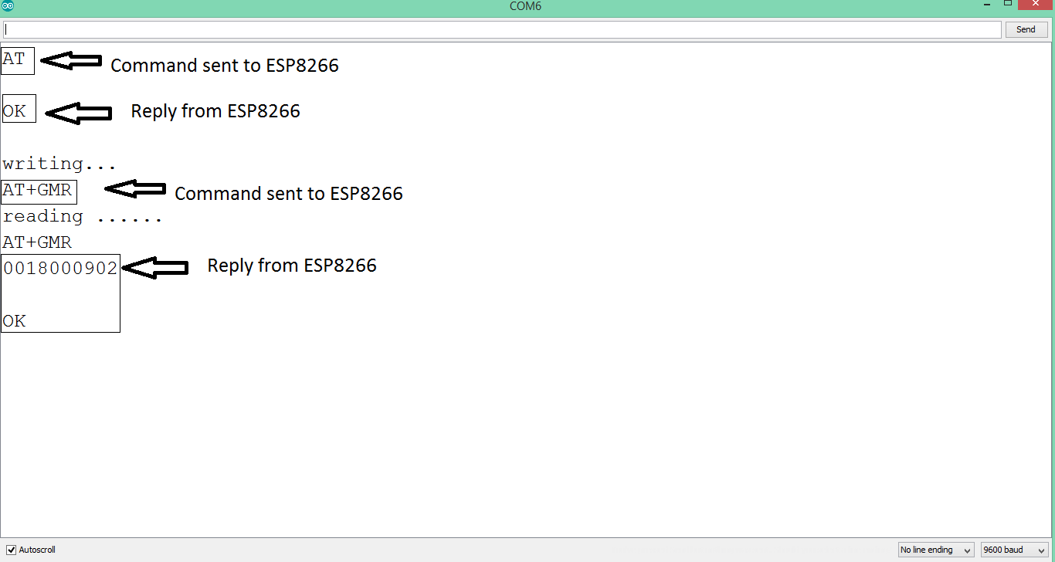
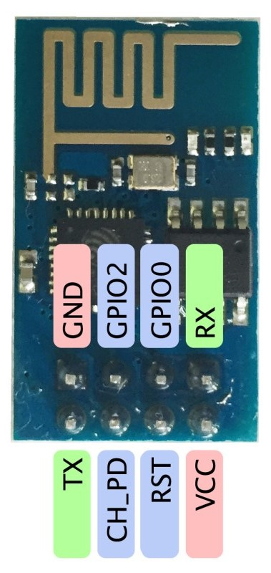
WIFI AT COMMUNICATION

Slide 10
METHODOLOGY:-
According to the dimension of object our system will create a protective virtual wall.
In our system, every device will be programmed to give them artificial intelligence.
In our project, every device will have intelligent feature to communicate with each other to get information of moving or static vehicle/devices.
This project can be installed easily.

Slide 11
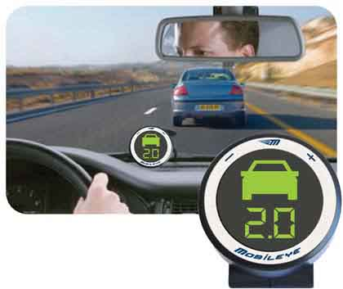
Warning Devices -
Visual head-up displays: warnings are displayed on the windshield in the driver's field of view.
Audio/Voice signals: auditory signals appear to be less intrusive on driving tasks

Slide 12
HOW IT WORKS:-
WORKING ON TWO DISCRIPTION :-
1. HARDWARE DISCRIPTION
2. SOFTWARE DISCRIPTION

Slide 13
HARDWARE DISCRIPTION
Arduino Nano (ATMEGA328P module)
ATMEGA328P microcontroller
Accelerometer
L293D power amplifier ic
Wi-Fi module ESP8266

Slide 14
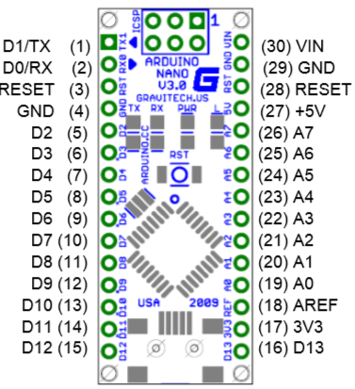
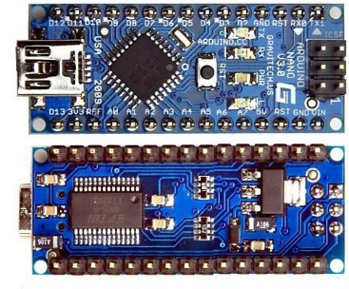
ARDUINO NANO

Slide 15
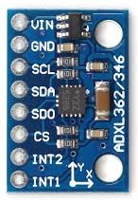
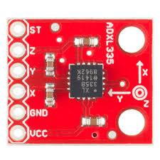
ACCELEROMETER
An accelerometer is a device that measures proper acceleration; proper acceleration is not the same as coordinate acceleration (rate of change of velocity).
Accelerometers are useful for sensing vibrations in systems or for orientation applications.
Digital Accelerometer
Analog Accelerometer

Slide 16
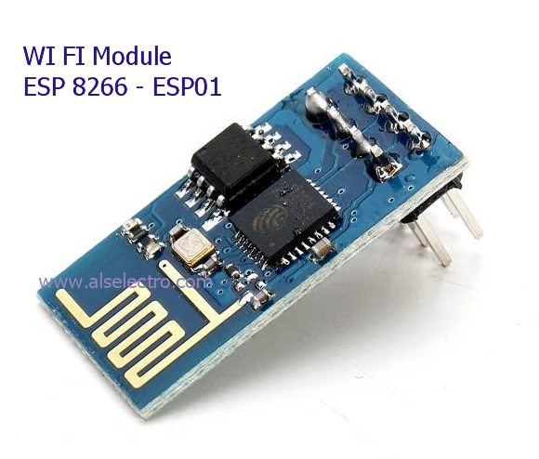
Wi-Fi module ESP8266

Slide 17
SOFTWARE DISCRIPTION
Arduino IDE (Integrated Development Environment)
Arduino IDE as Serial Monitor

Slide 18
SOFTWARE DISCRIPTION
PROGRAMS: - Centre vehicle AP
void setup() {
// put your setup code here, to run once:
pinMode(led, OUTPUT);
pinMode(led, OUTPUT);
wifi.begin(9600);
Serial.begin(9600);
wifi.println("AT+RST");
Serial.println(wifi.readString());
wifi.println("AT");
#include<SoftwareSerial.h>
SoftwareSerial wifi(7, 8);//Rx,Tx
int x = 1, y = 1;
int x2, y2, ip; // x and y of device 2
float phie;//angle of another
int r1 = 6, r2 = 6;
int led = 12, buzz = 13;
int distance;

Slide 19
SOFTWARE DISCRIPTION
PROGRAMS: - centre vehicle ap
//RESET
wifi.println("AT+CIPMUX=1");
Serial.println(wifi.readString());
wifi.println("AT+CIPSERVER=1,53");
Serial.println(wifi.readString());
}
Serial.println(wifi.readString());
wifi.println("AT+CWQAP");
Serial.println(wifi.readString());
wifi.println("AT+CWMODE=2");
Serial.println(wifi.readString());
wifi.println("AT+CWSAP=\"DEVICE1\",\"12345678\",4,0");
Serial.println(wifi.readString());

Slide 20
SOFTWARE DISCRIPTION
PROGRAMS: - centre vehicle ap
void analyze()
{
distance = (sqrt(pow((x2 - 1), 2) + pow((y2 - 1), 2)));
Serial.print("distance=");
Serial.println(distance);
if (distance <= r1 + r2)
{
Serial.print("\t\t UNSAFE\t\t");
Serial.println();
digitalWrite(led, HIGH);
tone(buzz, 2000);
//delay(100);
//digitalWrite(led, LOW);
noTone(buzz);
//delay(100);

Slide 21
SOFTWARE DISCRIPTION
PROGRAMS: - centre vehicle ap
tone(buzz, 2000);
//delay(100);
noTone(buzz);
delay(100);
tone(buzz, 2000);
delay(100);
noTone(buzz);
//delay(100);
tone(buzz, 2000);
//delay(100);
noTone(buzz);
//delay(100);
}
if (distance > r1 + r2)
{

Slide 22
SOFTWARE DISCRIPTION
PROGRAMS: - centre vehicle ap
Serial.print("\t\t SAFE\t\t");
Serial.println();
//movenormal();
digitalWrite(led, LOW);
digitalWrite(buzz, LOW);
}
}
void loop() {
// put your main code here, to run repeatedly:
while (wifi.available())
{
Serial.println("reading ......");
String st = "";
st = wifi.readString();
if (st[2] == '+' && st[3] == 'I' && st[4] == 'P' && st[5] == 'D')

Slide 23
SOFTWARE DISCRIPTION
PROGRAMS: - centre vehicle ap
{
// extracting x2 and y2 of device 2
Serial.println("Received extracting x2 and y2");
for (int i = 9; st[i] != NULL; i++) {
{
if (st[i] == 'X')
{
String instring = "";
x2 = 0;
y2 = 0;
phie = 0;
i++;
while (st[i] != 'Y')
{
instring += st[i];
i++;

Slide 24
SOFTWARE DISCRIPTION
PROGRAMS: - centre vehicle ap
}
x2 = x2 + instring.toInt();
Serial.println(x2);
instring = "";
i++;
while (st[i] != 'T')
{
//Serial.print(st[i]);
instring += st[i];
i++;
}
y2 = y2 + instring.toInt();
Serial.println(y2);
instring = "";
i++;
while (st[i] != 'E')
{
//Serial.print(st[i]);
instring += st[i];

Slide 25
SOFTWARE DISCRIPTION
PROGRAMS: - centre vehicle ap
i++;
}
ip = ip + instring.toInt();
phie = (ip / 100.00);
Serial.println(phie);
}
}
}
}
/*for (int i = 0; st[i] != NULL; i++) {
Serial.print("st[");
Serial.print(i);
Serial.print("]= ");
Serial.println(st[i]);
}*/
Serial.print(st);
Serial.println();
st = "";
}
while (Serial.available()) {
Serial.println("writing...");
String st1 = "";
st1 = Serial.readString();
Serial.println(st1);
wifi.println(st1);
st1 = "";
}
}
i++;
}
y2 = y2 + instring.toInt();
Serial.println(y2);
instring = "";
i++;
while (st[i] != 'E')
{
//Serial.print(st[i]);
instring += st[i];

Slide 26
Arduino IDE as Serial Monitor
The Arduino IDE has a feature that can be a great help in debugging sketches. The Serial Monitor is a separate pop-up window that acts as a separate terminal that communicates by receiving and sending Serial Data
The Serial Monitor is a separate pop-up window that acts as a separate terminal that communicates by receiving and sending Serial Data

Slide 27
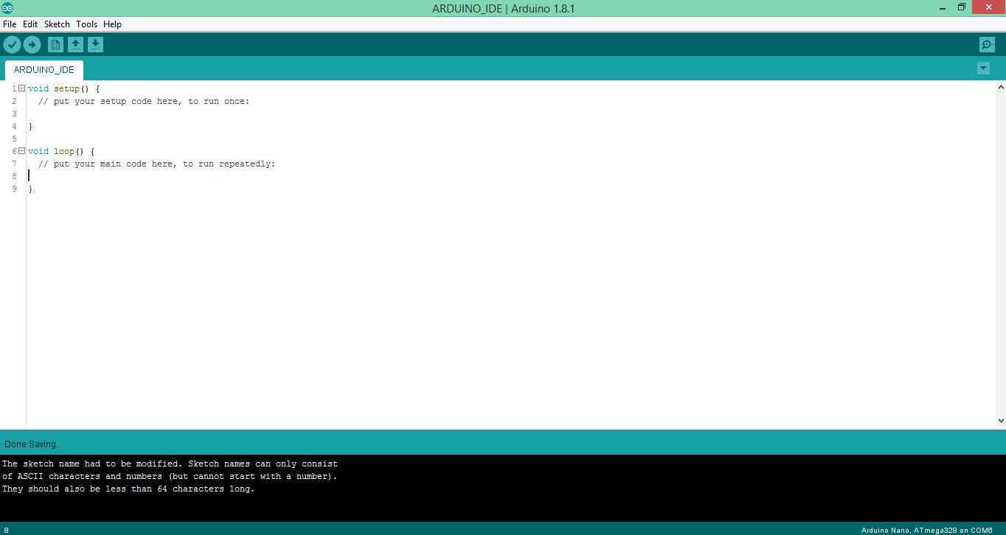
Arduino IDE (Integrated Development Environment)
The Arduino Nano is a small, complete The Arduino Nano is programmed using the Arduino IDE (Integrated Development Environment).
The Arduino Nano can be powered via the Mini-B USB connection.

Slide 28
CHALLENGES FACED
Communication of ESP8266 with ATMEGA328.
Problem faced while establishing connection between Wi-Fi devices.
Extracting and recognition of the feedback given by ESP8266.

Slide 29
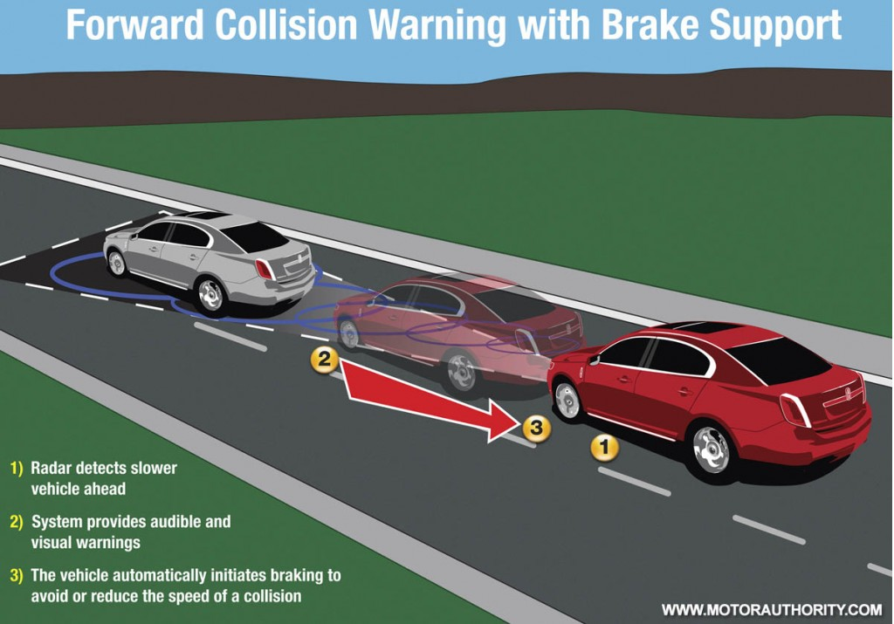
Control System of ANTICOLLISION
An audible warning,
Light braking & seat-belt retraction.
Strong braking & seat-belt retraction.

Slide 30
ADVANTAGE
Lower insurance costs. Because it is a thoroughly tested safety device with a track record of effectiveness,
Anti collision system using accelerometer and Wi-Fi technology decreases the death rate which occurred due to vehicle accident
The led system in car provide the alarm as a instruction to car before collision at certain distance.

Slide 31
DISADVANTAGE
Delicate systems. It's easy to cause a problem by messing around with the brakes. Slippery condition
Sometime approximate data can be sent by the device to the other vehicle, fluctuation of mini seconds

Slide 32
CONCLUSION
.The system which is the design and construction of an anti-collision system for vehicles was designed considering some factors such as economy, availability of components and research materials, efficiency, compatibility, portability and also durability
.The general operation of the system and performance is dependent on the presence of two moving cars as they get closer to each other
.The Wi-Fi P2P were make away from the power supply stage to prevent heat radiation which, might occur and affect the performance of the entire system.

Slide 33


